Slide 1


THE GARHWAL RIFLE REGIMENTAL CENTRE (GRRC)
WELCOME
INFORMATION TECHNOLOGY & CYBER AWARENESS
INTRODUCTION TO CLOUD COMPUTING

Slide 2
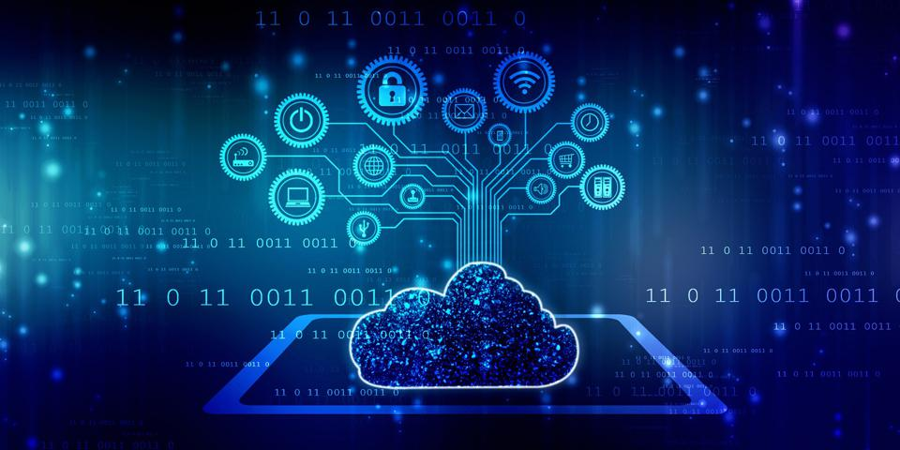
CLOUD COMPUTING

Slide 3
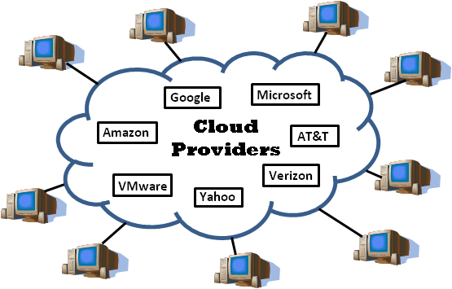
INTRODUCTION
Cloud computing is the use of internet to access and store data, run applications and use computing power from remote servers instead of your own computer or local servers.
This makes it easy to access your files and programs form anywhere with an internet connection.
Easy to use
Cost effective
Speed
Security

Slide 4
CLOUD COMPUTING
CHARACTERISTICS
  On demand self-service
    Users can access computing resources like storage, processing power and application whenever they need them, without requiring human intervention from the service provider.
    Broad NW access
      Cloud servers are accessible over the internet from a wide range of device such as smartphones, tablets, laptops and desktop.
      Rapid elasticity
      It means that you can quickly and easily increase or decrease the amount of computing resources you use, like storage , memory depends on your needs. This flexibility allows you to handle changes in demand without delay, ensuring that you always have the right amount of resources available.
      Mesured service
        Cloud systems automatically measure and monitor resources usage, allowing for transparent billing and usage tracking. This pay as you go model ensure that user only pay for the resource they actually use.

Slide 5
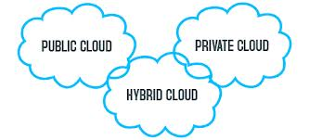
TYPES OF CLOUD COMPUTING

Slide 6
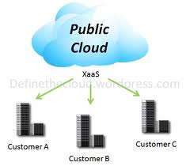
PUBLIC CLOUD
Made available to the general public- service provider
Microsoft, Google own and operate infrastructure
No visibility or control over the infrastructure
It is a type of cloud computing service where the resources like server storage and application are owned and operated by a third-party provider and are shared with many user over the internet. Providers like google cloud.

Slide 7
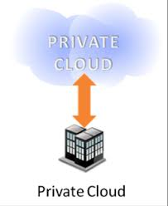
PRIVATE CLOUD
Infrastructure dedicated to a particular organization.
Ensures better security and control.
Service that is used exclusively by one organization unlike a public cloud, where resources are shared with many users a private cloud is dedicated to a single user or company offering more control, security and privacy.

Slide 8
HYBRID CLOUD
Composition of two or more clouds.
  Enviornments that mix at least one private cloud and one public cloud are called hybrid. They allow you to leverage the resources and services from different computing environments and choose which is the most optional for the workloads.

Slide 9
TYPES/ SERVICES OF CLOUD COMPUTING
SaaS (Software as a service)
it is way to deliver software over the internet. Instead of buying and installing software on your computer, you can access and use it online through a web browser. Eg: email server like Gmail don’t worry about installing updates or maintaining the software.
PaaS (Platform as a service)
it is cloud service that provides a platform for developers to build deploy and manage application over the internet. It includes everything needed for development such as server, storage and database along with tools and frameworks to create software example of PaaS google apps.
IaaS (Infrastructure as a service)
it is a cloud service that provides virtualized computing resource over the internet. It offers fundamental computing information like servers, storage and networking on a pay as you go. Instead of buying and managing physical hardware, you rent these resources from cloud providers and scale them up or down as needed. Eg: of IaaS include Amazon web server.

